Slide 1

Government College, Ropar
Dept. of English
Topic : Elements of a Short Story
Presented by: Prof. SandeepKumari

Slide 2
Elements of a Short Story
Notes:
Students will be provided a copy of the power point presentation in outline form. The outline form will have blanks to be filled in during the presentation. This presentation is in preparation of writing a short story for their portfolio. This presentation was designed for a resource Language Arts class; students having learning and behavior disorders.

Slide 3

Definition of a Short Story
Tells about a single event or experience
Fictional (not true)
500 to 15,000 words in length
It has a beginning, middle, and end
Creates an impression on the reader

Slide 4

Elements of a Short Story
Setting
Characterization
Plot
Conflict
Climax
Resolution
Theme
Point of view

Slide 5

Short Story Vocabulary
Setting:Tells the reader where and when the story takes place.

Slide 6

Short Story Vocabulary
Characterization: Creation of imaginary people who appear to be real to the reader. The writer gives information about the characters in the story.

Slide 7
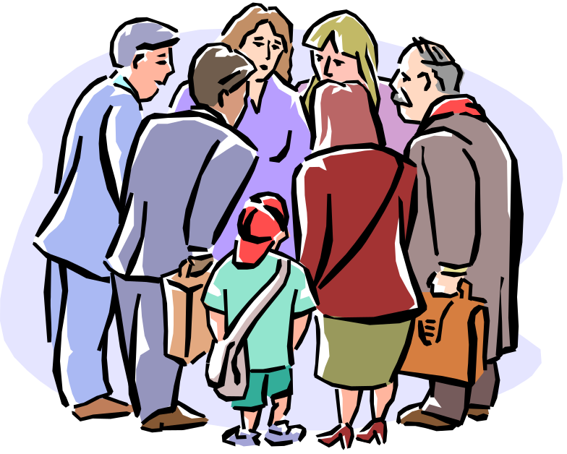
Short Story Vocabulary
Plot: A series of events through which the writer reveals what is happening, to whom, and why.

Slide 8
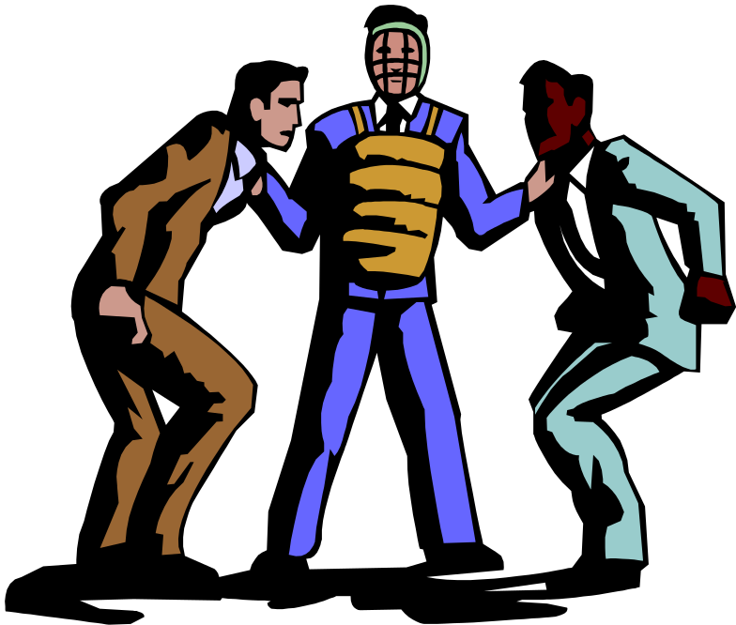
Short Story Vocabulary
Conflict: Is a problem in the story that needs to be resolved.

Slide 9
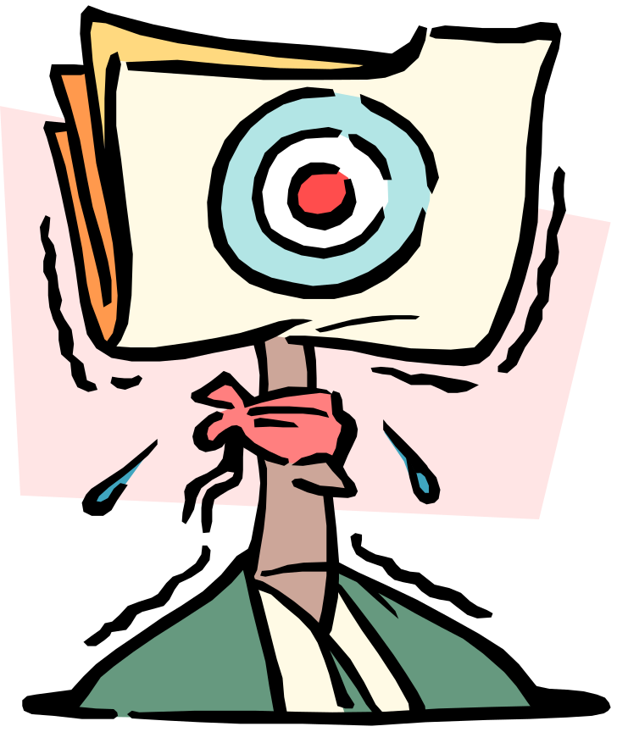
Short Story Vocabulary
Climax: When the action comes to its highest point of conflict.

Slide 10
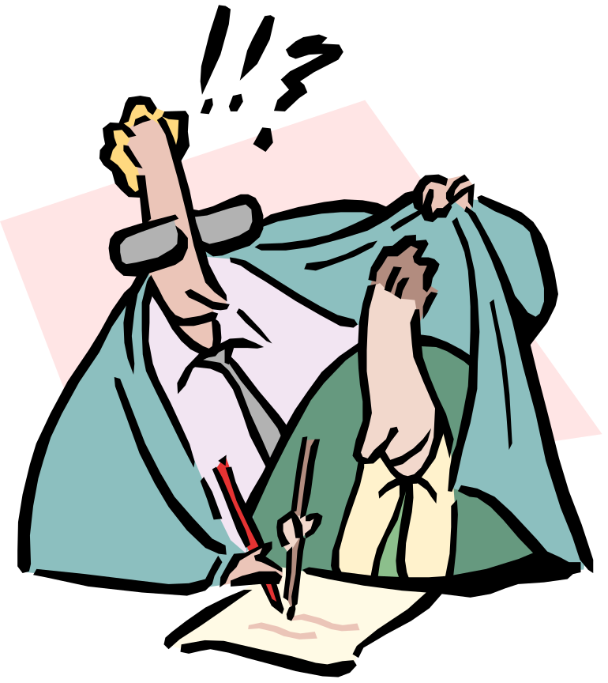
Short Story Vocabulary
Resolution: The story’s action after the climax until the end of the story. The “conclusion” of the story.

Slide 11

Short Story Vocabulary
Theme: The story’s main ideas. The “message” the writer intends to communicate by telling the story.

Slide 12

Short Story Vocabulary
Point of view: The position of the narrator of the story and what the writer sees from that vantage point.

Slide 13
Short Story
Great writers are able to use the elements of the short story with such precision that the reader is caught up in the action of the story. This is a mark of a good story and our goal as a writer.

Slide 14

THANK YOU

